Slide 1

MINI PROJECT
EVEN SEMESTER AY-2020
TOPIC :
VIRTUAL CLASSROOM

Slide 2
COURSE OBJECTIVES
The course “mini project” for this semester is focused on implementing a Graphical User Interface(GUI) based Application using Java. Swing is a library of JAVA that provides many tools which is used for creation of a GUI.
To incorporate a Database Management System to the Application such as MySQL, which is the database that is being used in this project. MySQL plays a very important role in storage management in this project.
To connect JAVA to MySQL using a tool called JDBC. In order to perform operations on the MySQL table via JAVA, JDBC is required.

Slide 3
ABSTRACT
“Virtual Classroom” ensures learning doesn't stop in difficult times, and also can be a great tool to share resource links and tasks to the students, and save records with the help of a well maintained database. It is necessary to have a medium to provide education in a convenient and flexible way, especially during difficult times like the Global Pandemic. When traveling becomes risky, it is possible to stay connected and exchange information virtually, this not only eliminates the distance barriers but also provides a plethora of flexibility in time and location. The aim of this project is to solve the problem by developing a GUI application that works as a virtual classroom, that can offer incomparable convenience and flexibility, this will ensure that learning doesn’t stop during such difficult times.

Slide 4
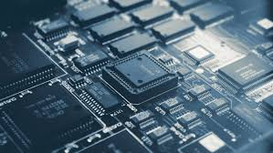
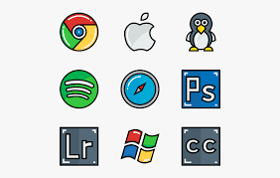
REQUIREMENTS
The requirements of the project are as follows:
Hardware Requirements:
Operating System – Windows 7, 8, 10
RAM – 1 GB or more
Processor Chip – Intel core i3, i5, i7
Software Requirements:
NetBeans IDE, MySQL Command Client

Slide 5

PROJECT OBJECTIVES
It is necessary to have a medium to provide education in a convenient and flexible way, especially during difficult times such as a Global Pandemic. When traveling becomes risky, it is possible to stay connected and exchange information virtually, this not only eliminates the distance barriers but also provides a plethora of flexibility in time and location.
The aim of this project is to solve the problem by developing a GUI application that works as a virtual classroom, that can offer incomparable convenience and flexibility, this will ensure that learning doesn’t stop during such difficult times.

Slide 6
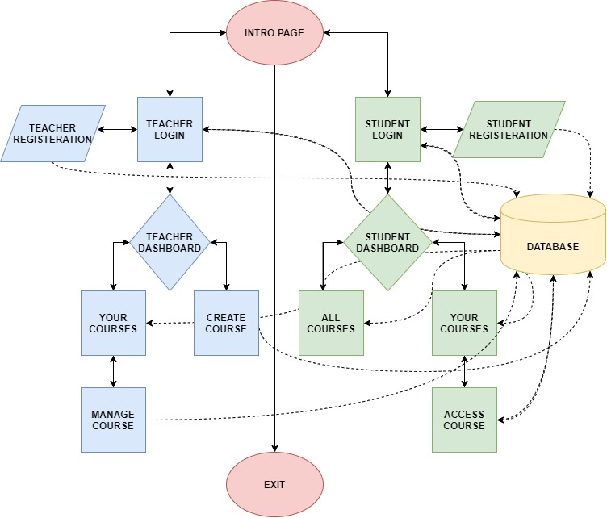
CONTROL FLOW DIAGRAM OF THE APPLICATION

Slide 7
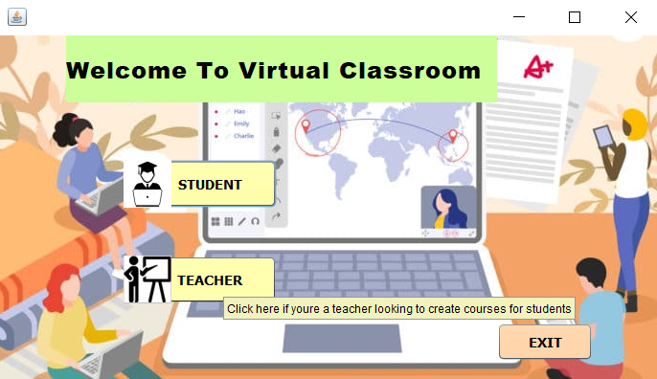
HIGHLIGHTED FEATURES
Tooltips throughout the buttons ensures no one is clueless on what the application does.

Slide 8
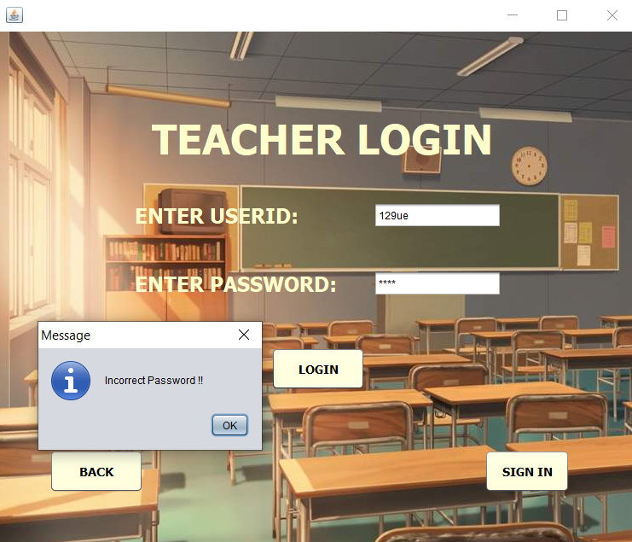
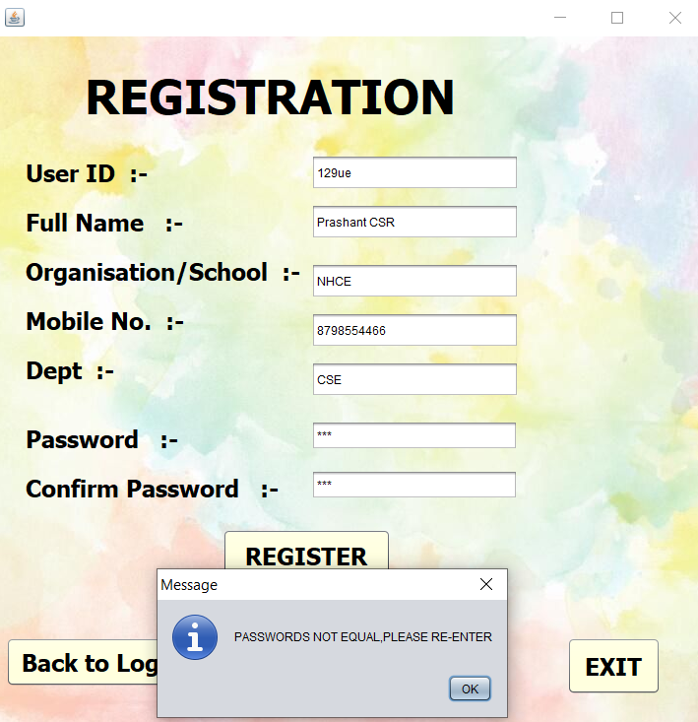
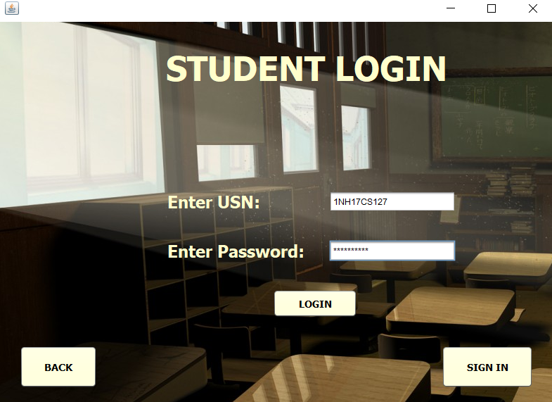
2. All kinds of anomalies during login/sign up removed

Slide 9
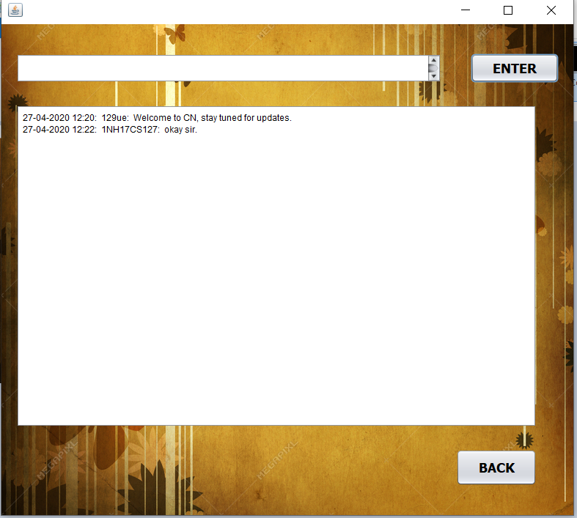
3. Each Course has a separate stream which acts as a medium to both teachers and students.

Slide 10
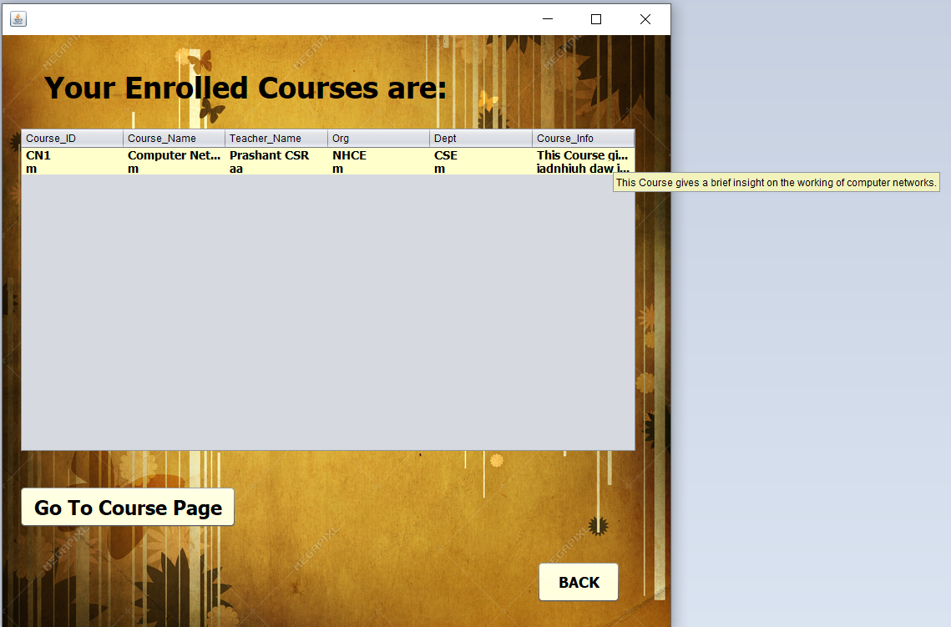
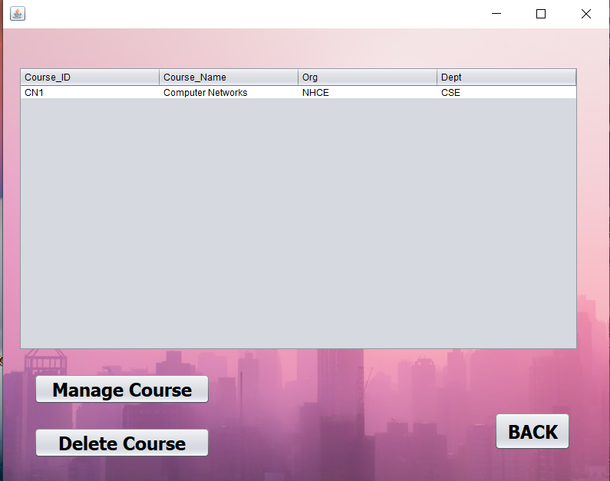
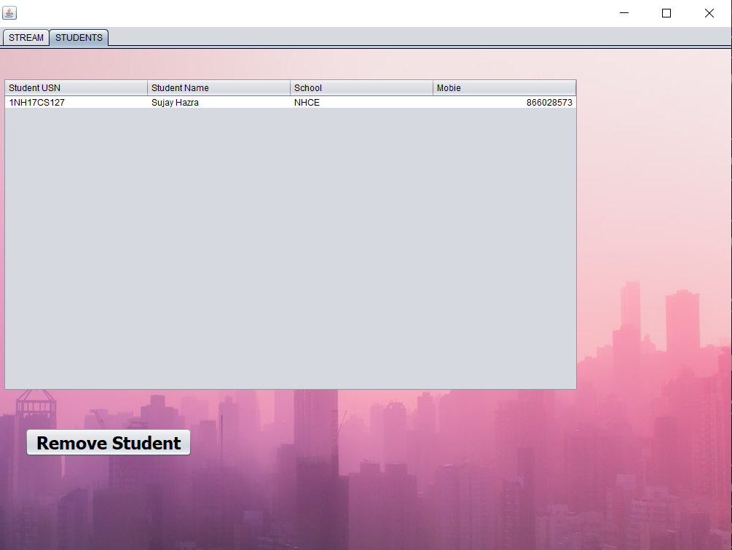
4. Use of tables makes it easier to visualize data and perform operations.

Slide 11
OBJECTIVES ACHIEVED
The following points ensure that a virtual medium for exchanging information and providing educational materials has been rendered successful :-
This application enables teachers from institutions to create courses and have students enroll to them and access them just like a virtual classroom
This environment allows two types of user Teacher/Student to access their unique dashboards and access the courses they have registered virtually.
This application also maintains a record separately for each of the courses registered by each of the students in databases.
This application provides a medium of communications between the students and teachers.

Slide 12
CONCLUSION
This application has a UI that is really simple and has taken all the possible user inputs into consideration to avoid anomalies and discrepancies, the user has to ensure that correct userID and password is entered to login after registering themselves in the application, each user has to provide a unique user ID, all the courses are well maintained, and can also be removed by the teacher.
This application ensures learning doesn't stop in difficult times, and also can be a great tool to share resource links and tasks to the students, and save records with the help of a well maintained database.
The user also has tooltip texts for each of the buttons in case they need assistance on using the app.
This project has given me an opportunity to explore the Java programming language and get an hands on experience on problem solving aspects while designing this application. Having a database as a back end provides the application with flexibility and a plethora of options to provide users with multiple facilities using various degree of queries.

Slide 13
THANK YOU
SUJAY HAZRA
1NH17CS127
6B

